Slide 1
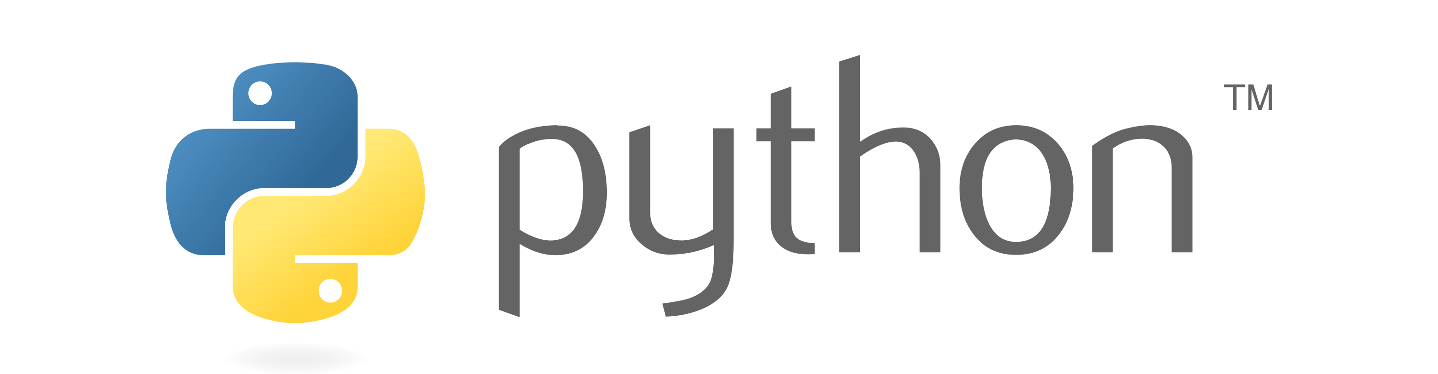

Slide 2
Array
In Python, Array is an object that provide a mechanism for storing several data items with only one identifier, thereby simplifying the task of data management. Array is beneficial if you need to store group of elements of same datatype. In Python, Arrays can increase or decrease their size dynamically.
Group of Integer- 10, 2, 40, 5, 6
Group of Float – 15.4, 25.4, 6.5

Slide 3
Arrays can store only one type of data.
In Python, The size of array is not fixed. Array can increase or decrease their size dynamically.
Array and List are not same.
Array uses less memory than List.

Slide 4
Why we need Array ?
101, 102, 103, 104, 105
stu1_roll = 101
stu2_roll = 102
stu3_roll = 103
stu4_roll = 104
stu5_roll = 105
print(stu1_roll)
print(stu2_roll)
print(stu3_roll)
print(stu4_roll)
print(stu5_roll)
101, 102, 103, 104, 105
stu_roll = array(‘i’,[101,102,103,104,105])
for element in stu_roll:
print(element)

Slide 5
Type of Array
One Dimensional Array / One D Array – Single Row Multiple Columns
Ex:- Student’s Roll Number
[101, 102, 103, 104, 105]
Multi-Dimensional Array / Multi D Array – Multiple Rows Multiple Columns
Ex:- Student’s Subject Marks
[40, 60, 70, 80, 30],
[50, 40, 60, 30, 40]
Note - Python does not support Multi-Dimensional Array but we can create Multi Dimensional Array using third party packages like numpy.
1st students Marks
2nd students Marks

Slide 6
One Dimensional Array
Single Row Multiple Columns
Ex:- [101, 102, 103, 104, 105]
Import Array Module
Two way to import array module:-
import array – This will import the entire array module.
from array import * - This will import all class, objects, variable etc from array module. Here * means All.

Slide 7
Creating and Initializing One-D Array
Module Name
Syntax:-
import array
array_name = array.array(‘type_code’, [elements])
Ex:-
From array import *
stu_roll = array(‘i’, [101, 102, 103, 104, 105])
Class Name
Object of Array Class

Slide 8
Index
An index represents the position number of an array’s element.
from array import *
stu_roll = array(‘i’, [101, 102, 103, 104, 105])
101 | 102 | 103 | 104 | 105
0 | 1 | 2 | 3 | 4
101 | 102 | 103 | 104 | 105
stu_roll[0] | stu_roll[1] | stu_roll[2] | stu_roll[3] | stu_roll[4]

Slide 9
Accessing One-D Array Elements
from array import *
stu_roll = array(‘i’, [101, 102, 103, 104, 105])
print(stu_roll[0])
print(stu_roll[1])
print(stu_roll[2])
print(stu_roll[3])
print(stu_roll[4])

Slide 10
Type Code
Type Code | C Type | Python Type | Size in bytes
b | Signed char | int | 1
B | Unsigned char | int | 1
h | Signed short | int | 2
H | Unsigned short | int | 2
i | Signed int | int | 2
I | Unsigned int | int | 2
l | Signed long | int | 4
L | Unsigned long | int | 4
q | Signed long long | int | 8
Q | Unsigned long long | int | 8
f | Float | float | 4
d | Double | float | 8

Slide 11
Accessing Array using while loop
from array import *
stu_roll = array(‘i’, [101, 102, 103, 104, 105])
n = len(stu_roll)
i = 0
while i < n :
print(stu_roll[i])
i+=1

Slide 12
append ( )
This method is used to add an element at the end of the existing array.
Syntax:-
array_name.append(new_element)
Object of Array Class

Slide 13
Getting User input
from array import *
stu_roll = array(‘i’, [ ])
n = int(input(“How many elements? ”))
for i in range(n):
stu_roll.append(int(input(“Enter Element: ”)))
for i in range(len(stu_roll)):
print(stu_roll[i])

Slide 14
insert( )
This method is used to insert an element in a particular position of the existing array.
Syntax:-
array_name.insert(position_number, new_element)

Slide 15
pop ( )
This method is used to remove last element from the existing array.
Syntax:-
array_name.pop( )

Slide 16
pop (n)
This method is used to remove an element specified by position number, from the existing array and returns removed element.
Syntax:-
array_name.pop(position_number)

Slide 17
remove( )
This method is used to remove first occurrence of given element from the existing array. If it doesn’t found the element, shows valueError.
Syntax:-
array_name.remove(element)

Slide 18
index( )
This method returns position number of first occurrence of given element in the array. If it doesn’t found the element, shows valueError.
Syntax:-
array_name.index(element)

Slide 19
reverse ( )
This method is used to reverse the order of elements in the array.
Syntax:-
array_name.reverse( )

Slide 20
extend( )
This method is used to append another array or iterable object at the end of the array
Syntax:-
array_name.extend(arr)

Slide 21
Slicing on Arrays
Slicing on arrays can be used to retrieve a piece of the array that contains a group of elements. Slicing is useful to retrieve a range of elements.
Syntax:-
new_array_name = array_name[start:stop:stepsize]

